Slide 1
Tic Tac Toe
Presented By
Lakshmi Saketh Chebrolu(101734216)

Slide 2
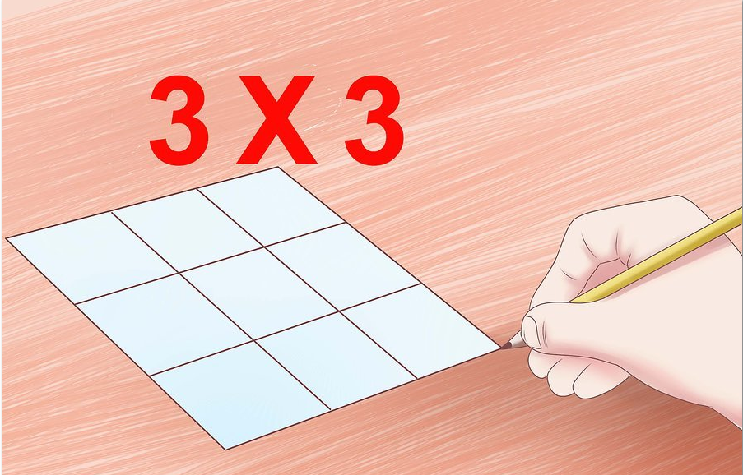

Slide 3
Game Rules
In this game we require two players
They have their unique symbols to mark in the game.
The Player will have 9 blocks in that blocks he has to place the symbol.

Slide 4
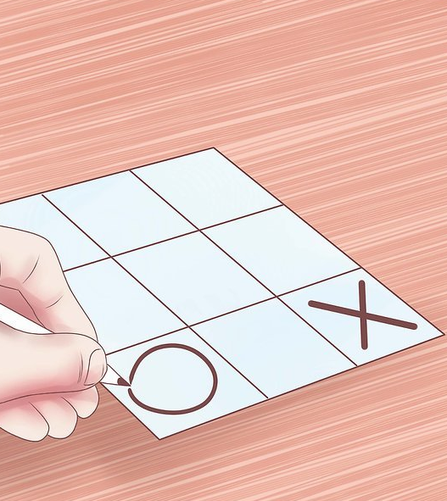
Game Rules
Alternatively the player should place their symbols in this 9 blocks.

Slide 5
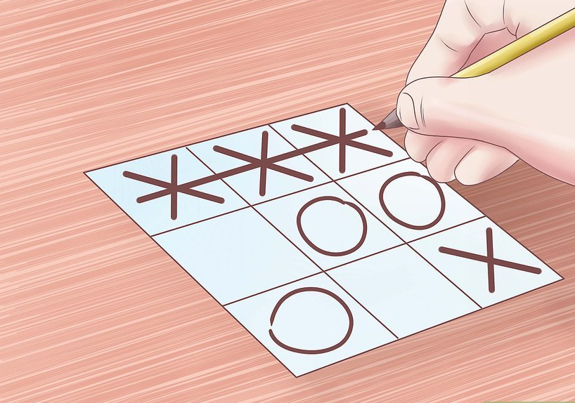
Game Rules
The winner of the game is decided when the player makes the Horizontal, vertical or cross match with same symbols.

